Slide 1


CX Journey Analytics Case Study
- Ashish Tomar
Purdue University

Slide 2
1
Business Problem
2
Data Exploration
3
Formulation of Success Metrics/KPIs
4
Comparative Analysis
AGENDA
5
Demographics Variation
Experiment Design Critique
6
Experiment Design Critique
7
Business Recommendations
8
Future Scope

Slide 3

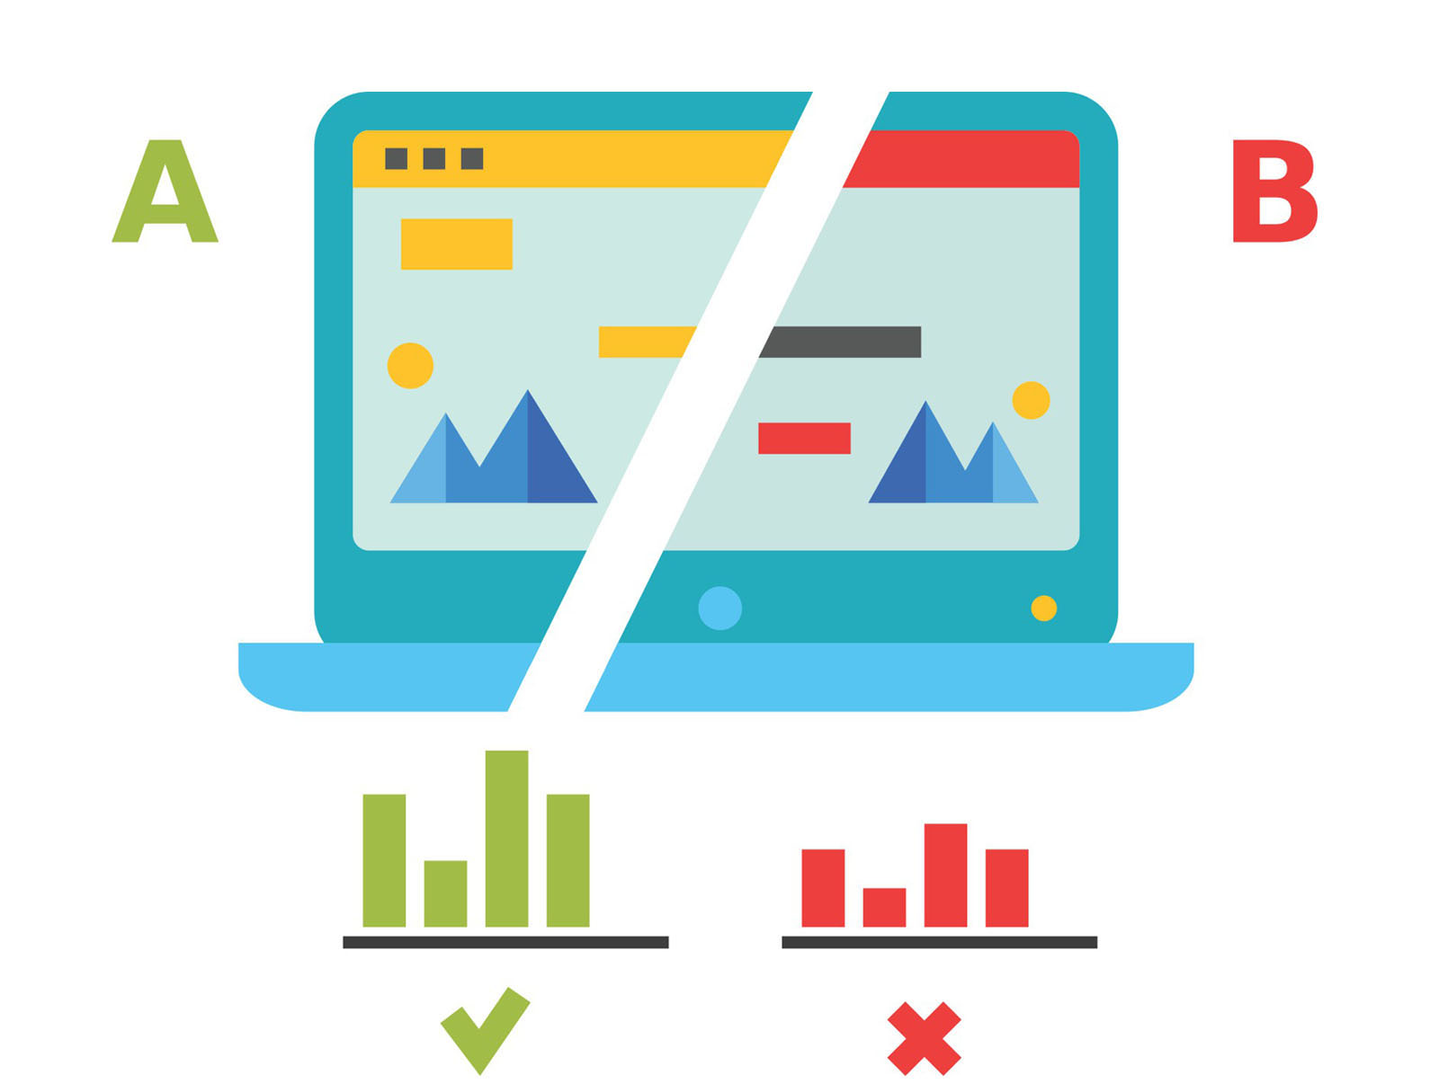




BUSINESS PROBLEM
Business problem
KPIs
Comparative Analysis
Demographic Variation
Recommendations
Data Exploration
Future Scope
Exp. Design Critique
GOAL
To statistically analyze the digital experiment designed to check performance of a new UI design of the process, through an A/B test
APPROACH
Metrics Formulation
Design success metrics to compare performance of the groups
Hypothesis Testing
Test the difference in metrics statistically
Experimental Design Analysis
Critique the digital experiment design
Analysis Enhancement Recommendations
Suggest methods to enhance testing to extrapolate business insights

Slide 4
Business problem
KPIs
Comparative Analysis
Demographic Variation
Recommendations
Data Exploration
Future Scope
Exp. Design Critique
DATA OVERVIEW
DS
- Dataset
DATASET | NUMBER OF RECORDS
Client Demographic Information | 70609
Web Hit Activity- Part 1 | 343141
Web Hit Activity- Part 2 | 412264
Group Classification | 70609
DS1
DS2
DS3
DS4
DATA PREPARATION
FINAL DATASET
DS1
JOIN
(
DS2
CONCAT
DS3
)
JOIN
DS4
=
321195 Records

Slide 5





Business problem
KPIs
Comparative Analysis
Demographic Variation
Recommendations
Data Exploration
Future Scope
Exp. Design Critique
SUCCESS METRICS
BOUNCE RATE
DROP-OFF RATE
CONFIRM RATE
NAVIGATION TIME
STEP RECURRENCE
Percentage of visits which started the process and left the process rather than continuing to the next step
Percentage of visits which hit a particular step and left the process rather than continuing to the next step
Percentage of visits which completed the entire process spanning all the steps
Average time spent on a particular step during navigation through the process
This metric is an indicator of the repetitions in a particular step rather than following a linear process flow
5

Slide 6



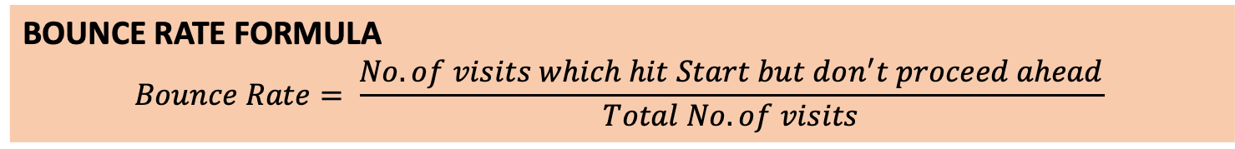
BOUNCE RATE
Business problem
KPIs
Comparative Analysis
Demographic Variation
Recommendations
Data Exploration
Future Scope
Exp. Design Critique
BUSINESS CONTEXT
Bounce rate measures the “stickiness” of the UI process, i.e. the ability of the design to engage the visitors deeper into the website
BOUNCE RATE FORMULA
$$Bounce Rate= \frac{No. of visits which hit Start but don^{′}t proceed ahead}{Total No. of visits}$$
COMPARISON OF BOUNCE RATES
Control Group Bounce Rate | Test Group Bounce Rate | Difference % (Test-Control) | Performance of Test Group
24.74% | 15.51% | -9.23% | 🙂

Slide 7
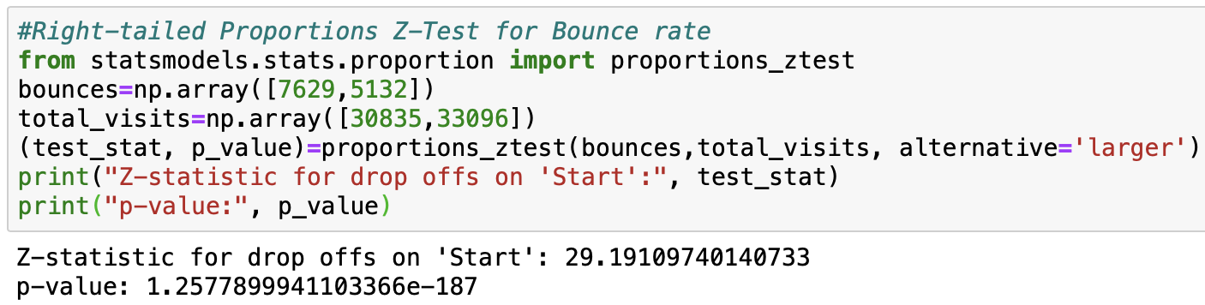
HYPOTHESIS TESTING FOR BOUNCE RATE
Business problem
KPIs
Comparative Analysis
Demographic Variation
Recommendations
Data Exploration
Future Scope
Exp. Design Critique
HYPOTHESIS FORMULATION
RIGHT-TAILED PROPORTIONS Z-TEST (at 95% confidence interval)
Null Hypothesis: The mean difference between the bounce rate in control group (μ_{c}) and test group (μ_{t}) is zero
H₀: μ_{c}=μ_{t}
Alternative Hypothesis: The test group (μ_{t}) has a lower mean bounce rate than that of control group (μ_{c})
H_{a}: μ_{c}>μ_{t}
BUSINESS CONCLUSION (at 𝜶=0.05)
Z-TEST RESULTS
It is statistically proved that the new UI design performs better in terms of user engagement
Decrease in bounce rate (Test-Control) | Z-score, p value | Test Result | Performance of Test Group
-9.23% | 29.19, 1.3e-187 | H₀ rejected | 😀

Slide 8
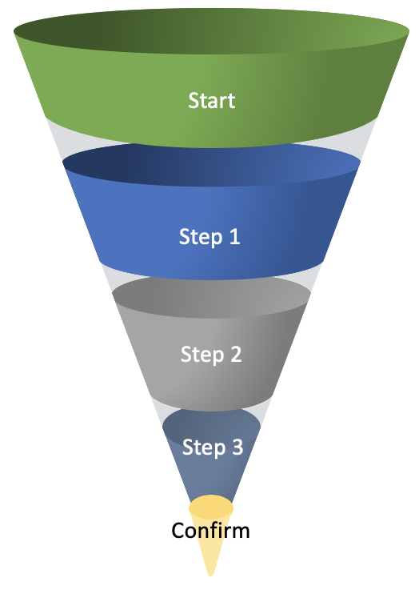
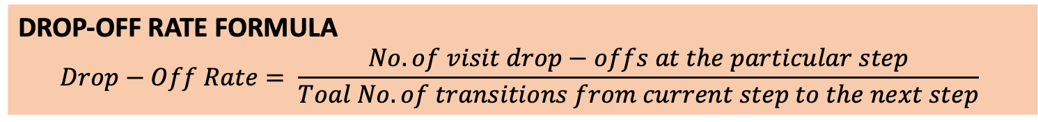
DROP-OFF RATE
Business problem
KPIs
Comparative Analysis
Demographic Variation
Recommendations
Data Exploration
Future Scope
Exp. Design Critique
BUSINESS CONTEXT
Drop-off rate measures the “stickiness” of the different steps in the UI process, i.e. the ability of each step to engage the visitors deeper into the website
DROP-OFF RATE FORMULA
$$Drop−Off Rate= \frac{No. of visit drop−offs at the particular step}{Toal No. of transitions from current step to the next step}$$
COMPARISON OF DROP_OFF RATES
Step | Control Group Drop-off Rate | Test Group Drop-off Rate | Difference % (Test-Control) | Performance of Test Group
Start | 27.23% | 22.07% | -5.16% | 🙂
Step 1 | 13.52% | 10.24% | -3.28% | 🙂
Step 2 | 6.42% | 5.17% | -1.25% | 🙂
Step 3 | 12.80% | 8.82% | -3.98% | 🙂

Slide 9
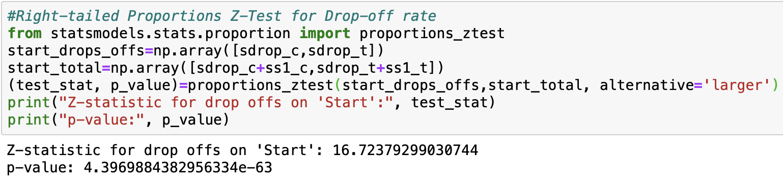
HYPOTHESIS TESTING FOR DROP-OFF RATE
Business problem
KPIs
Comparative Analysis
Demographic Variation
Recommendations
Data Exploration
Future Scope
Exp. Design Critique
HYPOTHESIS FORMULATION
RIGHT-TAILED PROPORTIONS Z-TEST (at 95% confidence interval)
Null Hypothesis: The mean difference between the step drop-off rate in control group (μ_{c}) and test group (μ_{t}) is zero
H₀: μ_{c}=μ_{t}
Alternative Hypothesis: The test group (μ_{t}) has a lower mean step drop-off rate than that of control group (μ_{c})
H_{a}: μ_{c}>μ_{t}
Z-TEST RESULTS
Step | Decrease in drop-off rate (Test-Control) | Z-score, p value | Test Result | Performance of Test Group
Start | -5.16% | 16.7, 4.4e-63 | H₀ rejected | 😀
Step 1 | -3.28% | 12.1, 9.8e-34 | H₀ rejected | 😀
Step 2 | -1.25% | 5.9, 2.4e-09 | H₀ rejected | 😀
Step 3 | -3.98% | 11.7, 7.7e-32 | H₀ rejected | 😀
BUSINESS CONCLUSION (at 𝜶=0.05)
It is statistically proved that all the steps in the new UI design perform better in terms of user engagement/“stickiness”

Slide 10

CONFIRM RATE
Business problem
KPIs
Comparative Analysis
Demographic Variation
Recommendations
Data Exploration
Future Scope
Exp. Design Critique
BUSINESS CONTEXT
Confirm rate measures the conversion of the web visits on the UI process, i.e. the ability of the design to help the visitors complete the process
CONFIRM RATE FORMULA
$$Confirm Rate= \frac{No. of distinct visits which hit ′Confirm′}{Total No. of visits}$$
COMPARISON OF CONFIRM RATES
Control Group Confirm Rate | Test Group Confirm Rate | Difference % (Test-Control) | Performance of Test Group
51.90% | 65.55% | 13.65% | 🙂

Slide 11
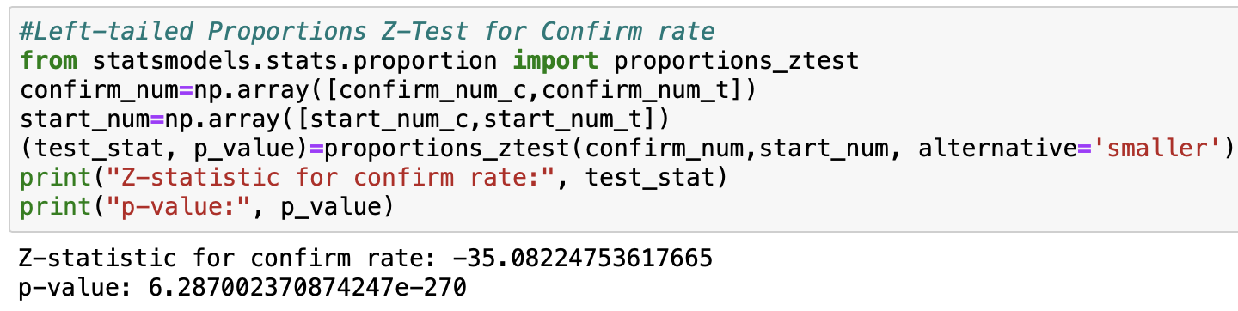
HYPOTHESIS TESTING FOR CONFIRM RATE
Business problem
KPIs
Comparative Analysis
Demographic Variation
Recommendations
Data Exploration
Future Scope
Exp. Design Critique
HYPOTHESIS FORMULATION
LEFT-TAILED PROPORTIONS Z-TEST (at 95% confidence interval)
Null Hypothesis: The mean difference between the confirm rate in control group (μ_{c}) and test group (μ_{t}) is zero
H₀: μ_{c}=μ_{t}
Alternative Hypothesis: The test group (μ_{t}) has a higher mean confirm rate than that of control group (μ_{c})
H_{a}: μ_{c}<μ_{t}
BUSINESS CONCLUSION (at 𝜶=0.05)
Z-TEST RESULTS
Increase in confirm rate (Test-Control) | Z-score, p value | Test Result | Performance of Test Group
13.65% | -35.08, 6.3e-270 | H₀ rejected | 😀
It is statistically proved that the new UI design performs better in terms of process completion

Slide 12
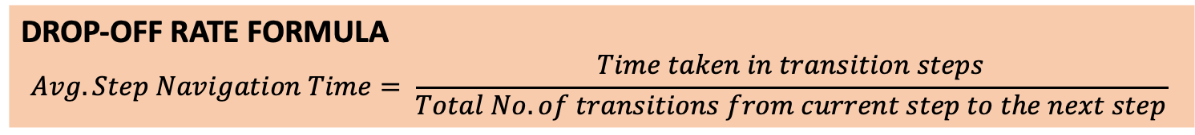
NAVIGATION TIME
Business problem
KPIs
Comparative Analysis
Demographic Variation
Recommendations
Data Exploration
Future Scope
Exp. Design Critique
BUSINESS CONTEXT
Navigation Time measures the transition smoothness of the different steps in the UI process, i.e. the ability of each step to help visitors proceed to the next step quickly
DROP-OFF RATE FORMULA
$$Avg. Step Navigation Time= \frac{Time taken in transition steps}{Total No. of transitions from current step to the next step}$$
COMPARISON OF AVG. NAVIGATION TIME
Step | Control Group Nav. Time (sec) | Test Group Nav. Time (sec) | Difference (Test-Control) | Performance of Test Group
Start | 37.64 | 31.03 | -6.61 | 🙂
Step 1 | 33.82 | 37.09 | 3.27 | 🙁
Step 2 | 87.09 | 86.51 | -0.58 | 🙂
Step 3 | 126.80 | 104.84 | -21.96 | 🙂

Slide 13
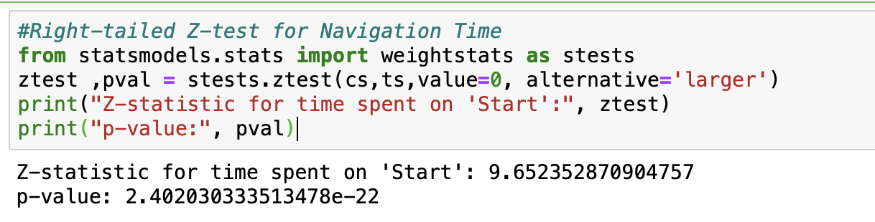
HYPOTHESIS TESTING FOR NAVIGATION TIME
Business problem
KPIs
Comparative Analysis
Demographic Variation
Recommendations
Data Exploration
Future Scope
Exp. Design Critique
HYPOTHESIS FORMULATION
RIGHT-TAILED Z-TEST (at 95% confidence interval)
Null Hypothesis: The mean difference between the navigation time in control group (μ_{c}) and test group (μ_{t}) is zero
H₀: μ_{c}=μ_{t}
Alternative Hypothesis: The test group (μ_{t}) has a lower mean navigation time that of control group (μ_{c})
H_{a}: μ_{c}>μ_{t}
Z-TEST RESULTS
BUSINESS CONCLUSION (at 𝜶=0.05)
Step | Decrease in nav. Time (Test-Control) | Z-score, p value | Test Result | Performance of Test Group
Start | -6.61 | 9.65, 2.4e-22 | H₀ rejected | 😀
Step 1 | 3.27 | No need of test | H₀ not rejected | 🙁
Step 2 | -0.58 | 0.82, 0.21 | H₀ not rejected | 🙁
Step 3 | -21.96 | 13.25, 2.19e-40 | H₀ rejected | 😀
It is statistically proved that Step 1 in the new UI design has a slower navigation time than the previous version. Start and Step3 in the new design have shorter navigation time, and Step2 is not significantly better than its old version.

Slide 14
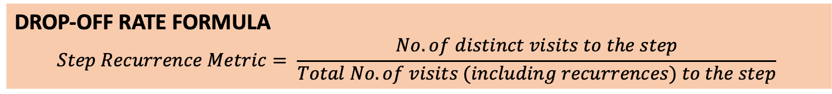
STEP RECURRENCE
Business problem
KPIs
Comparative Analysis
Demographic Variation
Recommendations
Data Exploration
Future Scope
Exp. Design Critique
BUSINESS CONTEXT
Step Recurrence Metric measures the transition smoothness of the different steps in the UI process, i.e. the ability of each step to help visitors proceed to the next step without recurrences
DROP-OFF RATE FORMULA
$$Step Recurrence Metric= \frac{No. of distinct visits to the step}{Total No. of visits (including recurrences) to the step}$$
COMPARISON OF AVG. NAVIGATION TIME
Step | Control Group Nav. Time (sec) | Test Group Nav. Time (sec) | Difference % (Test-Control) | Performance of Test Group
Start | 0.65 | 0.59 | -6% | 🙁
Step 1 | 0.79 | 0.73 | -6% | 🙁
Step 2 | 0.78 | 0.79 | 1% | 🙂
Step 3 | 0.80 | 0.86 | 6% | 🙂
Confirm | 0.92 | 0.84 | -8% | 🙁
Notes:
\

Slide 15
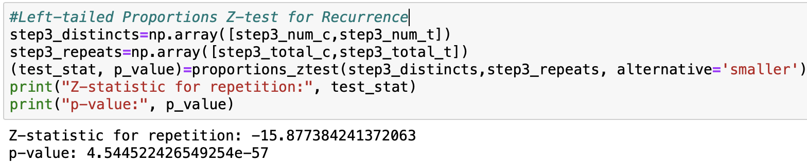
HYPOTHESIS TESTING FOR STEP RECURRENCE METRIC
Business problem
KPIs
Comparative Analysis
Demographic Variation
Recommendations
Data Exploration
Future Scope
Exp. Design Critique
HYPOTHESIS FORMULATION
LEFT-TAILED PROPORTIONS Z-TEST (at 95% confidence interval)
Null Hypothesis: The mean difference between the step recur. metric in control group (μ_{c}) and test group (μ_{t}) is zero
H₀: μ_{c}=μ_{t}
Alternative Hypothesis: The test group (μ_{t}) has a higher mean step recur. metric that of control group (μ_{c})
H_{a}: μ_{c}<μ_{t}
Z-TEST RESULTS
Step | Increase in step recurrence metric (%) (Test-Control) | Z-score, p value | Test Result | Performance of Test Group
Start | -6% | No need of test | H₀ not rejected | 🙁
Step 1 | -6% | No need of test | H₀ not rejected | 🙁
Step 2 | 1% | -3.67, 0.00012 | H₀ rejected | 😀
Step 3 | 6% | -15.88, 4.54e-57 | H₀ rejected | 😀
Confirm | -8% | No need of test | H₀ not rejected | 🙁
BUSINESS CONCLUSION (at 𝜶=0.05)
It is statistically proved that the new UI design performs worse than than the previous version in terms of step recurrence
15

Slide 16


ANALYSIS OF CLIENT INTERACTION WITH THE UI PROCESSES
Business problem
KPIs
Comparative Analysis
Demographic Variation
Recommendations
Data Exploration
Future Scope
Exp. Design Critique
Metrics Under Consideration
Confirm Rate
Drop-Off Rate
Navigation Time
Demographic Variables Under Consideration
Age
Tenure
Gender
Age-Balance
Tenure-Balance

Slide 17
VARIATION OF CONFIRM RATE WITH AGE
Business problem
KPIs
Comparative Analysis
Demographic Variation
Recommendations
Data Exploration
Future Scope
Exp. Design Critique
Confirm Rate - Age
BUSINESS INSIGHTS FOR PREVIOUS UI
BUSINESS INSIGHTS FOR CURRENT UI
CONTROL
Clients in the age groups 17-37 years and 37-57 years show a higher confirm rate.
TEST
Clients in the age group 17-37 years show a higher confirm rate.

Slide 18
VARIATION OF CONFIRM RATE WITH GENDER
Business problem
KPIs
Comparative Analysis
Demographic Variation
Recommendations
Data Exploration
Future Scope
Exp. Design Critique
Confirm Rate - Gender
BUSINESS INSIGHTS FOR PREVIOUS UI
BUSINESS INSIGHTS FOR CURRENT UI
CONTROL
Male clients show a slightly higher confirm rate than their female counterparts.
TEST
Male clients show a slightly higher confirm rate than their female counterparts.

Slide 19
VARIATION OF CONFIRM RATE WITH TENURE
Business problem
KPIs
Comparative Analysis
Demographic Variation
Recommendations
Data Exploration
Future Scope
Exp. Design Critique
Confirm Rate – Tenure
BUSINESS INSIGHTS FOR PREVIOUS UI
BUSINESS INSIGHTS FOR CURRENT UI
CONTROL
Clients in the tenure bin 33-44 years show the highest confirm rate, though there isn’t much difference among all the tenure bins from 1-44 years.
TEST
Clients in the tenure bin 33-44 years show the highest confirm rate, which is significantly higher than the other bins.

Slide 20
VARIATION OF DROP-OFF RATE WITH AGE
Business problem
KPIs
Comparative Analysis
Demographic Variation
Recommendations
Data Exploration
Future Scope
Exp. Design Critique
Drop-Off Rate - Age
BUSINESS INSIGHTS FOR PREVIOUS UI
BUSINESS INSIGHTS FOR CURRENT UI
CONTROL
Elderly people (77-97 years) show a high drop-off rate for all the steps
Step 3 has a very low drop-off rate for all the age groups.
TEST
Elderly people (77-97 years) show a high drop-off rate for all the steps, except Step 3. This may be due to the less technology friendly elderly age group.
It shows a general decrease compared to the new UI, indicating improved UI.
20

Slide 21
VARIATION OF DROP-OFF RATE WITH TENURE
Business problem
KPIs
Comparative Analysis
Demographic Variation
Recommendations
Data Exploration
Future Scope
Exp. Design Critique
Drop-Off Rate - Tenure
BUSINESS INSIGHTS FOR PREVIOUS UI
BUSINESS INSIGHTS FOR CURRENT UI
CONTROL
Step 3 drop-off rate for the people of maximum tenure (44-55 years) is exceptionally higher, which is a point of cause for investigation.
The drop-off rate for Step 1 is comparable to that of the new UI.
TEST
The drop rates of people with maximum tenure (44-55 years) is highest for all the steps.
This may be due to the less technology friendly elderly age group.
It shows a general decrease compared to the new UI, indicating improved UI.
21

Slide 22
VARIATION OF NAVIGATION TIME WITH AGE
Business problem
KPIs
Comparative Analysis
Demographic Variation
Recommendations
Data Exploration
Future Scope
Exp. Design Critique
Navigation Time - Age
BUSINESS INSIGHTS FOR PREVIOUS UI
BUSINESS INSIGHTS FOR CURRENT UI
CONTROL
Elderly clients tend to spend the maximum time in navigating through the process.
Step 2 is causing even the middle-aged group (37-57 years) to take longer in navigating, which should be looked further into.
TEST
Elderly clients tend to spend the maximum time in navigating through the process.
Step 2 is causing even the middle-aged group (37-57 years) to take longer in navigating.
The overall trends are similar to the previous UI, although the navigation time has decreased for all age groups.
22

Slide 23
VARIATION OF NAVIGATION TIME WITH TENURE
Business problem
KPIs
Comparative Analysis
Demographic Variation
Recommendations
Data Exploration
Future Scope
Exp. Design Critique
Navigation Time – Tenure
BUSINESS INSIGHTS FOR PREVIOUS UI
BUSINESS INSIGHTS FOR CURRENT UI
CONTROL
Experienced people with more tenure tend to navigate faster almost through all the steps.
TEST
Step 3 seems to cause people of all the tenure buckets take more time, esp. the more experienced people (44-55 years).
However, it shows a decrease compared to the new UI, indicating improved UI.

Slide 24
VARIATION OF CLIENT BALANCE WITH AGE
Business problem
KPIs
Comparative Analysis
Demographic Variation
Recommendations
Data Exploration
Future Scope
Exp. Design Critique
Client Balance-Age
BUSINESS INSIGHTS FOR PREVIOUS UI
BUSINESS INSIGHTS FOR CURRENT UI
CONTROL
Elderly clients (age groups 57-77 & 77-97 years) have the maximum balance
Although there are less number of clients in that age group, elderly clients are a valuable customer segment for Vanguard.
TEST
Elderly clients (age groups 57-77 & 77-97 years) have the maximum balance
Although there are less number of clients in that age group, elderly clients are a valuable customer segment for Vanguard.

Slide 25
VARIATION OF CLIENT BALANCE WITH TENURE
Business problem
KPIs
Comparative Analysis
Demographic Variation
Recommendations
Data Exploration
Future Scope
Exp. Design Critique
Client Balance-Age
BUSINESS INSIGHTS FOR PREVIOUS UI
BUSINESS INSIGHTS FOR CURRENT UI
CONTROL
Clients with high tenure (22-33, 33-44 & 44-55 years) have the maximum balance.
Although there are a smaller number of clients in that tenure bucket, experienced clients are a valuable customer segment for Vanguard.
TEST
Clients with high tenure (22-33, 33-44 & 44-55 years) have the maximum balance.
Although there are a smaller number of clients in that tenure bucket, experienced clients are a valuable customer segment for Vanguard.

Slide 26



EXPERIMENTAL DESIGN EFFECTIVENESS
Business problem
KPIs
Comparative Analysis
Demographic Variation
Recommendations
Future Scope
Exp. Design Critique
Data Exploration
RANDOMIZATION
To eliminate any possible bias
REPLICATION
Increase the sample size to reduce the uncertainty in experiment
BLOCKING
Divide groups into homogeneous brackets to account for further biases

Slide 27
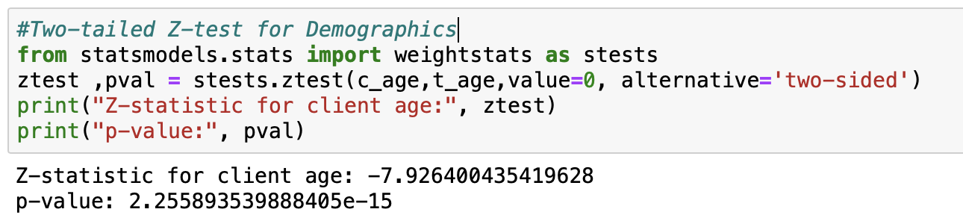
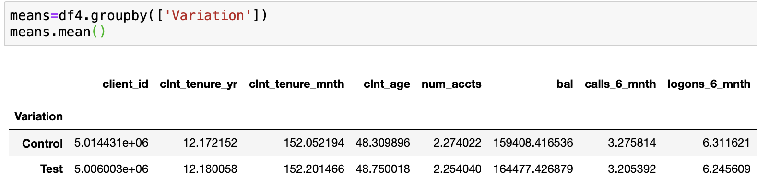
HYPOTHESIS TESTING FOR DEMOGRPAHICS
Business problem
KPIs
Comparative Analysis
Demographic Variation
Recommendations
Data Exploration
Future Scope
Exp. Design Critique
HYPOTHESIS FORMULATION
TWO-TAILED PROPORTIONS Z-TEST (at 95% confidence interval)
Null Hypothesis: The mean difference between the age/tenure/balance etc. in control group (μ_{c}) and test group (μ_{t}) is zero.
H₀: μ_{c}=μ_{t}
Alternative Hypothesis: The mean difference between the age/tenure/balance etc. in control group (μ_{c}) and test group (μ_{t}) is not zero.
H_{a}: μ_{c}≠μ_{t}
Z-TEST RESULTS
Demographic | Z-score, p value | Test Result | Performance of Test Group
Age | -7.93, 2.2e-15 | H₀ rejected | ☹️
Tenure | -0.51, 0.6 | H₀ not rejected | 😀
Acc. No. | 10.40, 2.5e-25 | H₀ rejected | ☹️
Balance | -4.09, 4.3e-05 | H₀ rejected | ☹️
Calls | 9.05, 1.5e-19 | H₀ rejected | ☹️
Logons | 8.53, 1.4e-17 | H₀ rejected | ☹️
Gender | 0.73, 0.5 | H₀ not rejected | 😀
BUSINESS CONCLUSION
It is statistically proved that the two groups are not similar, and there is a possibility of external biases in the experiment
27

Slide 28




UI EXPERIMENT DESIGN CRITIQUE
Business problem
KPIs
Comparative Analysis
Demographic Variation
Recommendations
Data Exploration
Future Scope
Exp. Design Critique
Criterion | Status | Verdict
Randomization of demographics | Hypothesis Testing proved dissimilarity of the two groups on various features | 🙁
Sample Size | The sample size of visits was good enough with total of 321195 data entries | 🙂
Duration of time period | The duration of testing was good enough with the test spanning over 1.5 months, as the statistical significance of most of the metrics could be proved | 🙂
Distribution over the week | The test included all 7 days of the week to avoid day-based bias | 🙂
Concurrent testing | Both the test and control groups underwent the test at the same time, concurrently | 🙂
CONCLUSION: Though the experiment followed many of the requirements, but it wasn’t randomized sufficiently. Thus, it’s not a great experiment design, and needs proper sampling to get rid of biases.

Slide 29
BUSINESS RECOMMENDATIONS
Business problem
KPIs
Comparative Analysis
Demographic Variation
Recommendations
Future Scope
Exp. Design Critique
Data Exploration
Success Metric | New UI Performance | Verdict
Bounce Rate | New UI has a lower bounce rate | 😀
Confirm Rate | New UI has a higher confirm rate | 😀
Drop-off Rate | New UI has lower drop-off rates for all the steps | 😀
Navigation Time | New UI has faster navigation in most of the steps | 🙂
Step recurrence metric | Multiple steps in the new UI face more recurrences | 🙁
RECOMMENDATION: Client Experience Team should go ahead with the implementation of the new UI, as it performs better on most of the tested success metrics, though experimental design should be improved for better credibility of testing results

Slide 30






FUTURE SCOPE
Business problem
KPIs
Comparative Analysis
Demographic Variation
Recommendations
Future Scope
Exp. Design Critique
Data Exploration
TIME DURATION OF TESTING
RANDOMIZED BLOCK DESIGN (ANCOVA)
Fundamental Blocks of A/B Testing
Age
Tenure
Lift
Conf. Interval
Sample Size
$ Constraint
Gender
Account Balance
Potential Business Requirements
Extra Data Points for Granular Analysis
Smaller sample size→ More time duration
Higher confidence interval→More time duration
Lift requirement→Impacts time duration
SUCCESS METRIC: ‘Company Sales’ can be used as a success metric to compare performance of the groups, assuming the aim of the digital process to be commercial
DEMOGRAPHIC DATA: Details like ‘Household Income’, ‘Marital Status’, ‘Race’, ‘Ethnicity’, ‘Education’, ‘Employment Status’ can be used for further randomization of samples
CONCLUSION: Based on business requirements around confidence interval and lift, the experiment can be run longer

Slide 31
THANK YOU!

